Slide 1
INFO251 – Applied Machine Learning
Lab 11
Qutub Khan Vajihi

Slide 2
Announcements
PS6 launched! Due on April 19th, 11:59PM.
You will mainly be working on Decision Trees, RF, SVM and Neural Nets

Slide 3
Agenda
Neural Networks
Tensorflow – Some notes

Slide 4
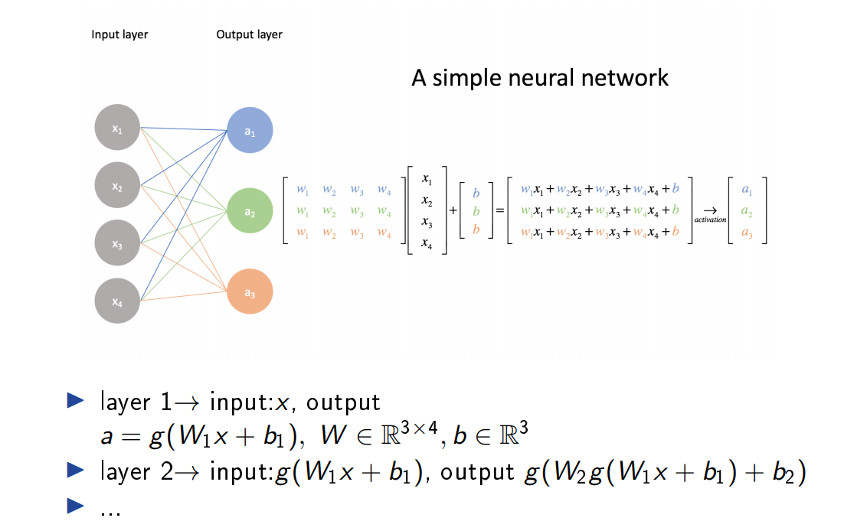
Neural Networks

Slide 5
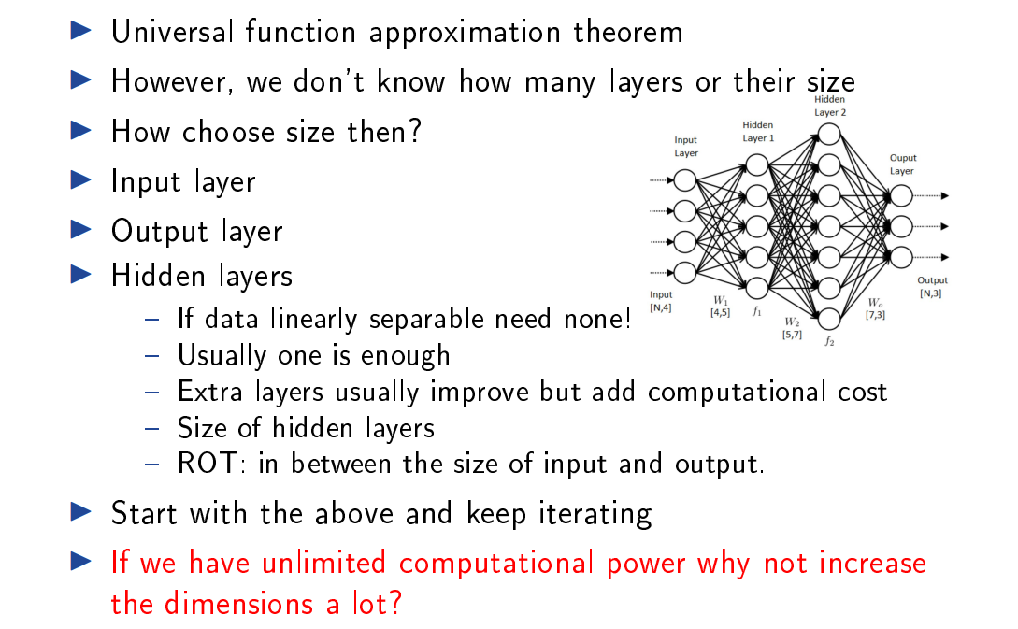
Neural Networks

Slide 6
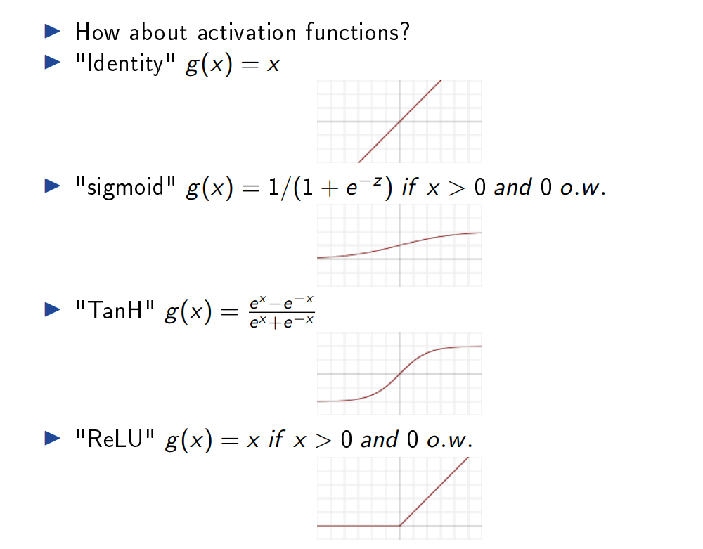
Neural Networks

Slide 7
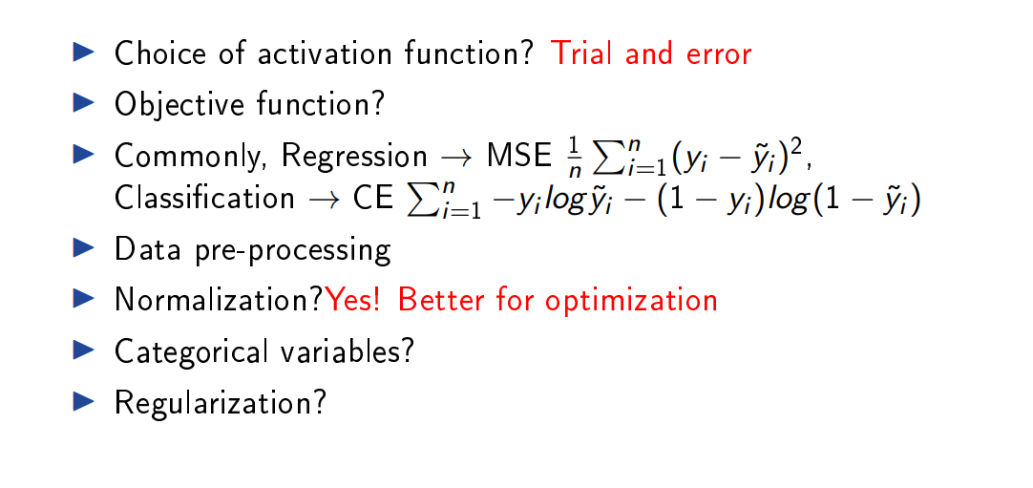
Neural Networks

Slide 8
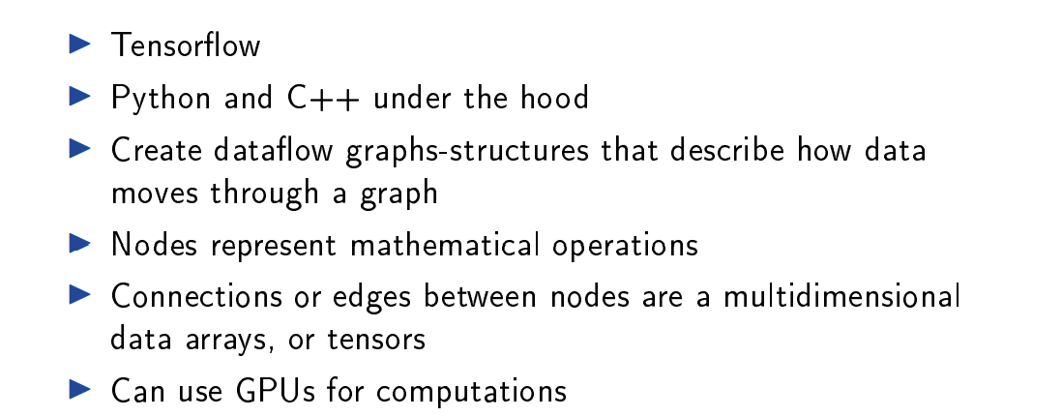
Tensorflow

Slide 9
Over to the notebook.

